Slide 1
PFOS/PFOA Off-Base Drinking Water Impacts
Ms. Melody Jensen
AFCEC/CZOM
11 December 2018

Slide 2
Overview
PFOS/PFOA Timeline at Ellsworth AFB
Off-Base Drinking Water Well Sampling
Future plans

Slide 3
PFC Timeline at Ellsworth
2011 - PFCs detected at the (FT001) as part of Broad Agency Announcement
2013 - Remedial Investigation (RI) Funded
2014 - Limited Site Investigation (SI) Completed at 6 Sites
2015 - Preliminary Assessment Completed
2016 - Stage 1 Fieldwork for the RI Completed
2016 - EPA established lifetime Health Advisory drinking water for
PFOA/PFOA of 70 ppt
2016 - Off-Base Private Well Identified & Sampled
2016 - Alternate Water Supply Provided to Impacted Landowners
2018 - Stage 2 Fieldwork for the RI Completed
2018 - SI Fieldwork Completed
2018 - Off-Base Private Drinking Water Well Survey /Sampling
Future - Stage 3 Fieldwork & Complete RI

Slide 4
Off-Base Drinking Water Well Sampling
Private well sampled in 2016 (99 ppt) and again in 2017 (182 ppt)
Connected 2 impacted properties to alternate water source
Off-Base Door to Door Private Well Survey/Sampling
Phase 1: 18 Sept 2018 – 24 wells sampled
12 Drinking water wells (9 above EPA Lifetime Health Advisory)
10 Irrigation wells (8 above EPA LHA)
Phase 2: 29 Oct 2018 – 27 Drinking water wells sampled
2 Wells above EPA LHA
Phase 3: 29 Nov 2018 – 16 wells sampled
10 Drinking water wells (4 above EPA LHA)
6 Irrigation wells (2 above EPA/LHA)
Alternate Water provided to properties above EPA LHA

Slide 5
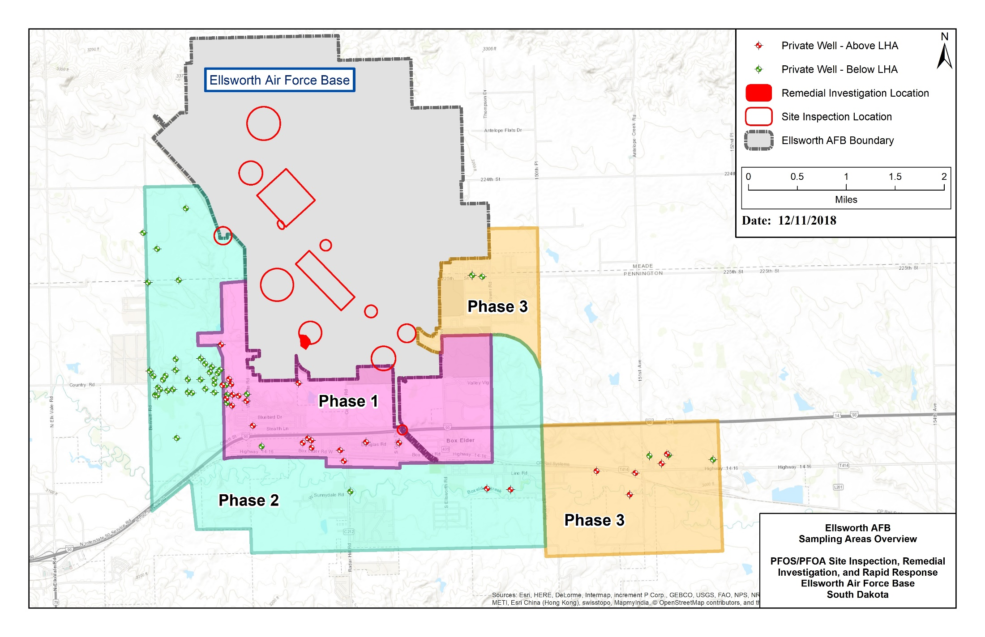
Off-Base Drinking Water Well Sampling

Slide 6
Future Plans
Finalize the PFOS/PFOA Remedial Investigation for site FT001
Continue to identify and sample off-base drinking water wells for PFOS/PFOA using the 3-Ps
Proximity
Probability
Pathway
Continue to provide alternate water to impacted properties
Provide bottled water until permanent solutions are implemented
Work with property owners to design/install treatment systems (reverse osmosis) on drinking water wells
Connect properties to municipal water system if available
Work with municipal water systems to expand service area or capacity if feasible

Slide 7
Contact Information
Melody Jensen
AFCEC/CZOM
2125 Scott Dr
Ellsworth AFB 57706
605-385-2677
Melody.jensen.1@us.af.mil

